Slide 1
Latest headline
To help users stay updated with the latest news headlines, tailored to their interests.
Team Members:
S.bhuvaneswaran
K.Karthi
S.Boomika
A.ishwarya

Slide 2
Introduction
Stay informed with Latest Headline, your go-to Android app for the latest news and trending headlines. Whether you’re interested in global events, local news, or specific topics, this app delivers real-time updates from multiple trusted news sources directly to your device.
The app provides a single platform to access the latest headlines from multiple sources.
Personalized news feed based on user interests (e.g., politics, sports, technology, etc.).
Real-time updates for breaking news, trending topics, and special events.
Easy-to-read design with an intuitive interface.

Slide 3
Key Features
Personalized News Feed: Customize your news experience by selecting categories that matter most to you—be it politics, sports, technology, entertainment, or more.
Real-Time Updates: Get breaking news alerts as soon as they happen, keeping you in the loop throughout the day.
Easy Navigation: Browse headlines with ease using an intuitive, user-friendly interface designed for quick access to your favorite stories.
Save & Share Headlines: Bookmark your favorite headlines to read later or share them with friends and family on social media.
Push Notifications: Receive notifications about important or breaking news stories, ensuring you never miss an update.

Slide 4
User Flow
App Launch → Welcome screen or user login (optional).
Personalization – Choose interests or topics.
Browse Headlines – Display real-time, categorized headlines.
Save/Share/Read – Users can save or share headlines.
Push Notifications – Alert users to breaking news.
Settings – Customize app preferences (e.g., notification settings, categories).

Slide 5
App Design
Showcase the app’s clean and modern design.
Highlight the simple, user-friendly interface: minimalistic layout, easy navigation, and quick access to news categories.
Include screenshots of key screens (e.g., Home Screen, News Feed, Headline Detail Page).
Mention use of Material Design Principles for intuitive user experience
Technology Stack
Frontend (UI): Kotlin/Java (Android Development)
Backend: Firebase for user authentication and cloud database
News API Integration: Use of NewsAPI or custom API integration to pull headlines from multiple sources.
Push Notifications: Firebase Cloud Messaging (FCM)
Analytics: Google Analytics or Firebase Analytics to track app usage and engagement.
Cloud Hosting: Firebase or AWS for cloud infrastructure.

Slide 6
Development Roadmap
Phase 1 (MVP): Core features (headline aggregation, basic user profile, simple UI).
Phase 2: User personalization, push notifications, and advanced filtering.
Phase 3: Monetization features (ads, subscriptions, affiliate marketing).
Phase 4: Continuous updates, improvements, and expanding news sources.
User Feedback and Testing
Early feedback from beta testers indicated a positive response to the real-time updates and personalized news feed.
Conduct usability tests and A/B testing to improve user experience.
User Retention Rate: Focus on improving retention through meaningful notifications and content suggestions.

Slide 7
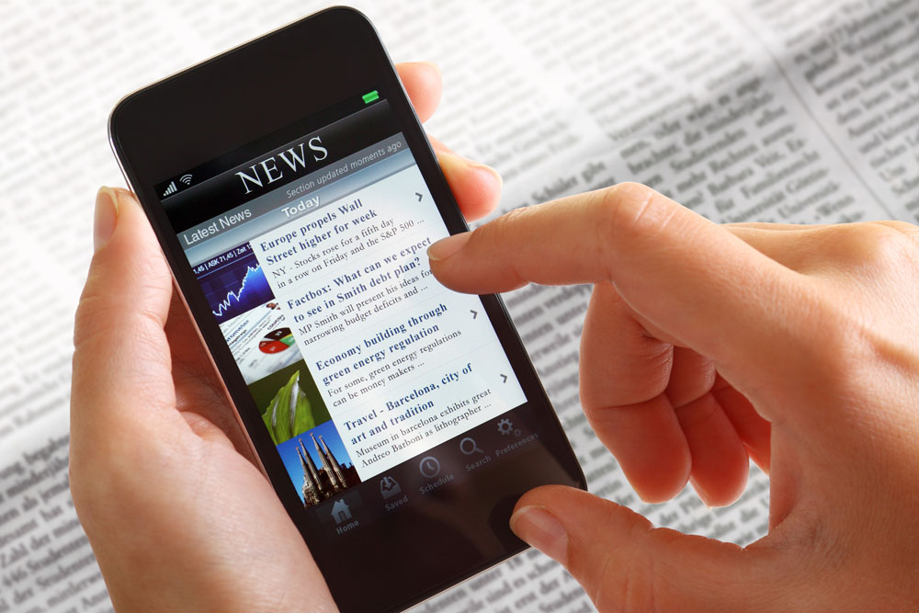
“Latest Headline News TODAY”

Slide 8
Kotlin Implementation Dependencies
dependencies {
implementation("com.squareup.okhttp3:okhttp:4.10.0")
implementation("com.google.code.gson:gson:2.8.8")
}

Slide 9
Main Activity.kt:
import okhttp3.OkHttpClient
import okhttp3.Request
import com.google.gson.Gson
data class Article(val title: String, val description: String, val url: String)
data class NewsResponse(val status: String, val totalResults: Int, val articles: List<Article>)
fun fetchLatestHeadlines(apiKey: String) {
val client = OkHttpClient()
val request = Request.Builder()
.url("https://newsapi.org/v2/top-headlines?country=us&apiKey=$apiKey")
.build()
client.newCall(request).execute().use { response ->
if (!response.isSuccessful) {
println("Failed to fetch data: ${response.message}")
return
}

Slide 10
val responseData = response.body?.string()
val newsResponse = Gson().fromJson(responseData, NewsResponse::class.java)
println("Total Headlines: ${newsResponse.totalResults}")
for (article in newsResponse.articles) {
println("Title: ${article.title}")
println("Description: ${article.description}")
println("URL: ${article.url}")
println("------")
}
}
}
fun main() {
val apiKey = "your_news_api_key_here"
fetchLatestHeadlines(apiKey)
}

Slide 11
Java Implementation MainActivity.java:
import okhttp3.OkHttpClient;
import okhttp3.Request;
import okhttp3.Response;
import com.google.gson.Gson;
import java.io.IOException;
import java.util.List;
class Article {
String title;
String description;
String url;
}
class NewsResponse {
String status;
int totalResults;
List<Article> articles;
}

Slide 12
public class NewsFetcher {
public static void fetchLatestHeadlines(String apiKey) throws IOException {
OkHttpClient client = new OkHttpClient();
String url = "https://newsapi.org/v2/top-headlines?country=us&apiKey=" + apiKey;
Request request = new Request.Builder().url(url).build();
try (Response response = client.newCall(request).execute()) {
if (!response.isSuccessful()) {
System.out.println("Failed to fetch data: " + response.message());
return;
}
String responseData = response.body().string();
Gson gson = new Gson();
NewsResponse newsResponse = gson.fromJson(responseData, NewsResponse.class);
System.out.println("Total Headlines: " + newsResponse.totalResults);
for (Article article : newsResponse.articles) {
System.out.println("Title: " + article.title);
System.out.println("Description: " + article.description);
System.out.println("URL: " + article.url);

Slide 13
System.out.println("------");
}
}
}
public static void main(String[] args) {
String apiKey = "your_news_api_key_here"; // Replace with your NewsAPI key
try {
fetchLatestHeadlines(apiKey);
} catch (IOException e) {
e.printStackTrace();
}
}
}

Slide 14
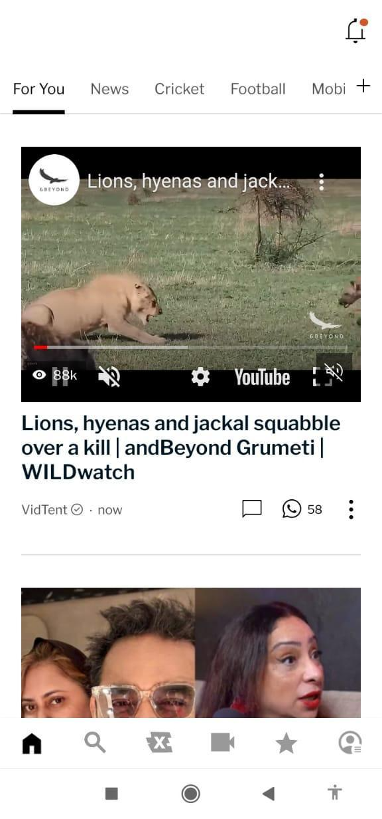
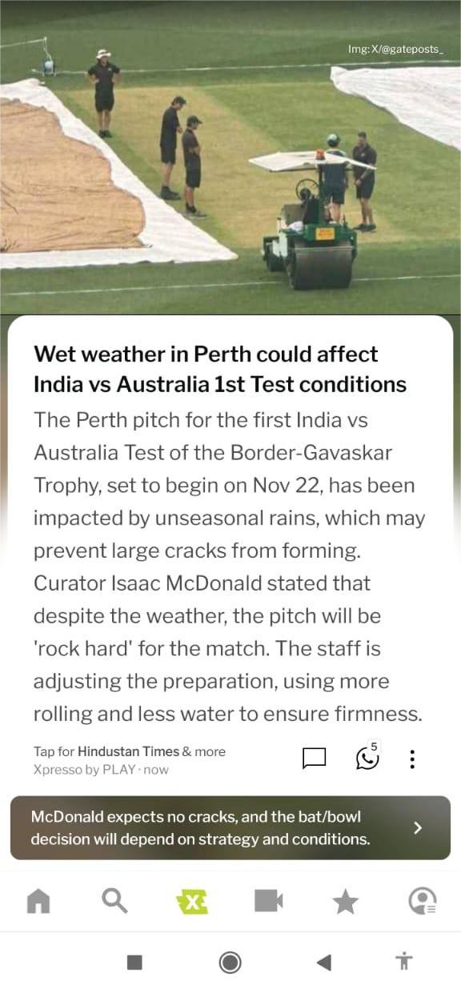
OUTPUT:

Slide 15
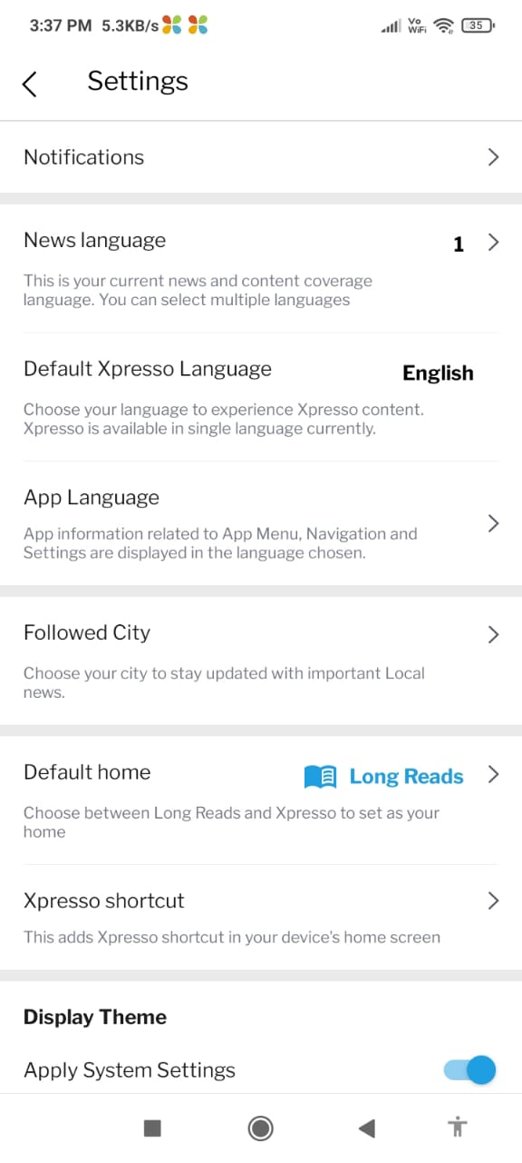

Slide 16
CONCLUSION
“Latest headline news” app is the ultimate tool for staying updated with personalized news, delivering the latest headlines in real time.

Slide 17
THANK YOU
S.Bhuvaneswaran
aut815822104007

